Slide 1
Fraud Detection in Digital and Netbanking Using Machine Learning

Slide 2
Abstract
Fraud detection in digital and net banking is crucial to ensuring secure financial transactions. This project leverages machine learning algorithms to identify fraudulent activities based on transaction patterns and anomalies. By analyzing real-time data, the system enhances fraud detection accuracy while reducing false positives. Advanced techniques such as anomaly detection and supervised learning improve banking security. The proposed model helps prevent financial fraud, ensuring safer digital banking experiences.

Slide 3
Introduction
With the rise of digital and net banking, fraudulent activities have become a major concern for financial institutions. Traditional rule-based fraud detection methods are often ineffective against evolving cyber threats. This project implements machine learning algorithms to detect suspicious transactions by analyzing patterns and anomalies. Techniques such as supervised learning, anomaly detection, and deep learning improve fraud detection accuracy. The system processes real-time transaction data to minimize financial losses and enhance security. By reducing false positives and improving detection efficiency, this model helps banks prevent fraud effectively. Ultimately, it ensures a safer and more secure digital banking experience for users.

Slide 4
Existing System
Traditional fraud detection systems rely on rule-based approaches and manual verification, which are often inefficient and slow. These systems struggle to adapt to evolving fraud techniques, leading to high false positives and undetected fraudulent transactions. They primarily use predefined thresholds, making them ineffective against complex cyber threats. Additionally, real-time fraud detection is challenging due to the lack of automated analysis and machine learning capabilities. As a result, financial institutions face significant financial losses and security risks.

Slide 5
Proposed System
The proposed system utilizes machine learning algorithms to detect fraudulent transactions with high accuracy. By analyzing transaction patterns and identifying anomalies, it enables real-time fraud detection with minimal false positives. Techniques such as supervised learning, anomaly detection, and deep learning enhance the system’s adaptability to evolving fraud tactics. The model continuously learns from new data, improving detection efficiency over time. This approach ensures a secure and reliable digital banking experience, reducing financial risks for users and institutions.

Slide 6
LITERATURE REVIEW
Research in fraud detection highlights the limitations of traditional rule-based systems, which struggle to detect evolving fraud patterns. Studies show that machine learning algorithms, such as supervised and unsupervised learning, significantly improve fraud detection accuracy. Recent advancements in deep learning and anomaly detection have enhanced real-time transaction monitoring. Various research papers emphasize the need for adaptive models that continuously learn from fraud patterns. This project builds on these findings to develop a robust fraud detection system for digital banking.

Slide 7
Modules:
Data Preprocessing: The data preprocessing module handles the cleaning and transformation of raw transaction data, ensuring it is in the right format for analysis. It removes inconsistencies, missing values, and normalizes the data for machine learning models.
Feature Extraction & Classification: This module extracts important features from transaction data and applies classification algorithms to identify patterns. It uses techniques like decision trees, random forests, and neural networks for accurate fraud detection.
RGB Composite & Band Selection: This module uses RGB composites and band selection to analyze the visual data representation of transaction patterns. It selects the most relevant data features for model training and improves prediction accuracy.
Interactive Visualization: Interactive visualization tools are used to display real-time insights from the fraud detection system. This module allows users to explore detailed fraud patterns through dynamic graphs, heatmaps, and charts.
Model Deployment & Performance Analysis: The deployment module ensures that the fraud detection model is integrated into the banking system. Performance analysis evaluates the model’s accuracy, precision, and recall to ensure effective fraud detection in live environments.

Slide 8
Algorithms Used:
Convolutional Neural Networks (CNNs): CNNs are utilized for their ability to automatically extract features from transaction data and images. These networks help in identifying complex patterns within data, enhancing fraud detection accuracy through deep learning.
Principal Component Analysis (PCA): PCA is employed for dimensionality reduction, transforming high-dimensional data into a lower-dimensional space while preserving important information. This improves model efficiency and reduces computational complexity during fraud detection.
Softmax Classifier: The Softmax classifier is used in the final layer of the neural network to assign probabilities to each class (fraudulent or legitimate). It helps in multi-class classification, ensuring precise prediction of transaction outcomes.
Data Augmentation Techniques: Data augmentation techniques, such as synthetic data generation, are applied to increase the diversity of the training data. This improves model generalization and helps the system adapt to different fraud scenarios.
Adam Optimizer & Cross-Entropy Loss: The Adam optimizer is used for efficient weight updating, ensuring faster convergence during training. Cross-entropy loss is used to measure the difference between predicted and actual outcomes, optimizing the model’s accuracy in fraud detection.

Slide 9
Software Components:
Programming Language:The project is developed using Python, a versatile programming language with rich libraries for machine learning, data analysis, and image processing.
Frameworks & Libraries: Several frameworks and libraries are used for model development and analysis:
TensorFlow/Keras or PyTorch: These libraries are used for building and training deep learning models such as CNNs, with high flexibility and efficient GPU support.
OpenCV: Utilized for image and video processing, particularly for extracting features and visualizing patterns related to fraud detection.
Scikit-learn: This library is used for implementing various machine learning algorithms, including classification models like decision trees, random forests, and PCA.
Pandas & NumPy: These libraries are essential for data manipulation, cleaning, and performing numerical operations on transaction datasets.
Matplotlib & Seaborn: Used for data visualization, generating charts, heatmaps, and graphs to better understand transaction data and fraud patterns.
Streamlit: A web application framework used for creating interactive dashboards, enabling real-time visualization of fraud detection results.
Hardware Components:
Processor: A multi-core processor (Intel i5 or higher) is required for efficient data processing and model training.
RAM: At least 8 GB of RAM is recommended to handle large datasets and ensure smooth model execution.
Storage: A minimum of 500 GB of storage is required to store transaction data, models, and related resources.
GPU (Highly Recommended): A dedicated GPU (such as NVIDIA GTX/RTX) is highly recommended for accelerating deep learning model training and handling large volumes of transaction data in real-time.
Cloud GPU (Optional for Deployment): Cloud GPU services (such as Google Colab, AWS, or Azure) can be utilized for model deployment and scaling when deploying the solution to handle high-volume, real-time fraud detection.

Slide 10
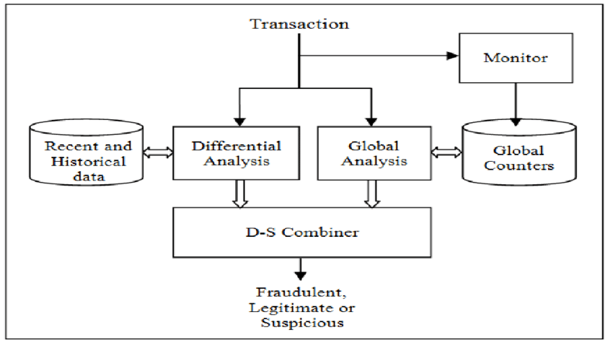
Block Diagram

Slide 11
UML Diagrams
Use Case Diagram
Data Flow Diagram
Sequence Diagram
State Diagram

Slide 12
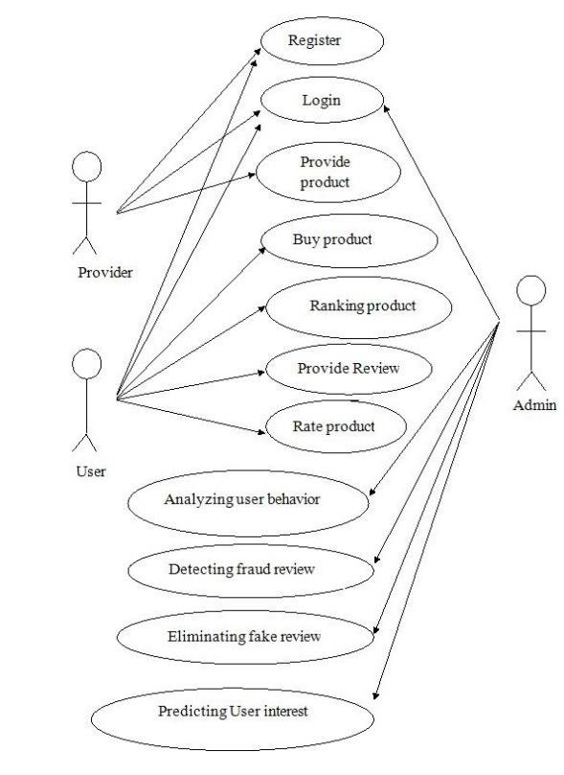
Use case Diagrams

Slide 13
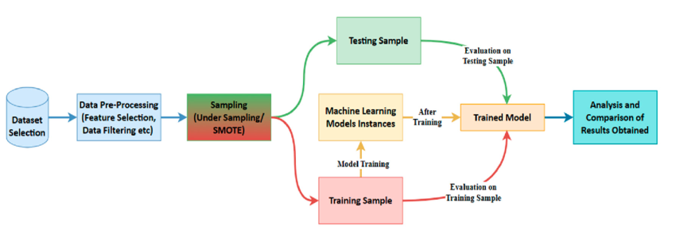
Data Flow Diagrams

Slide 14
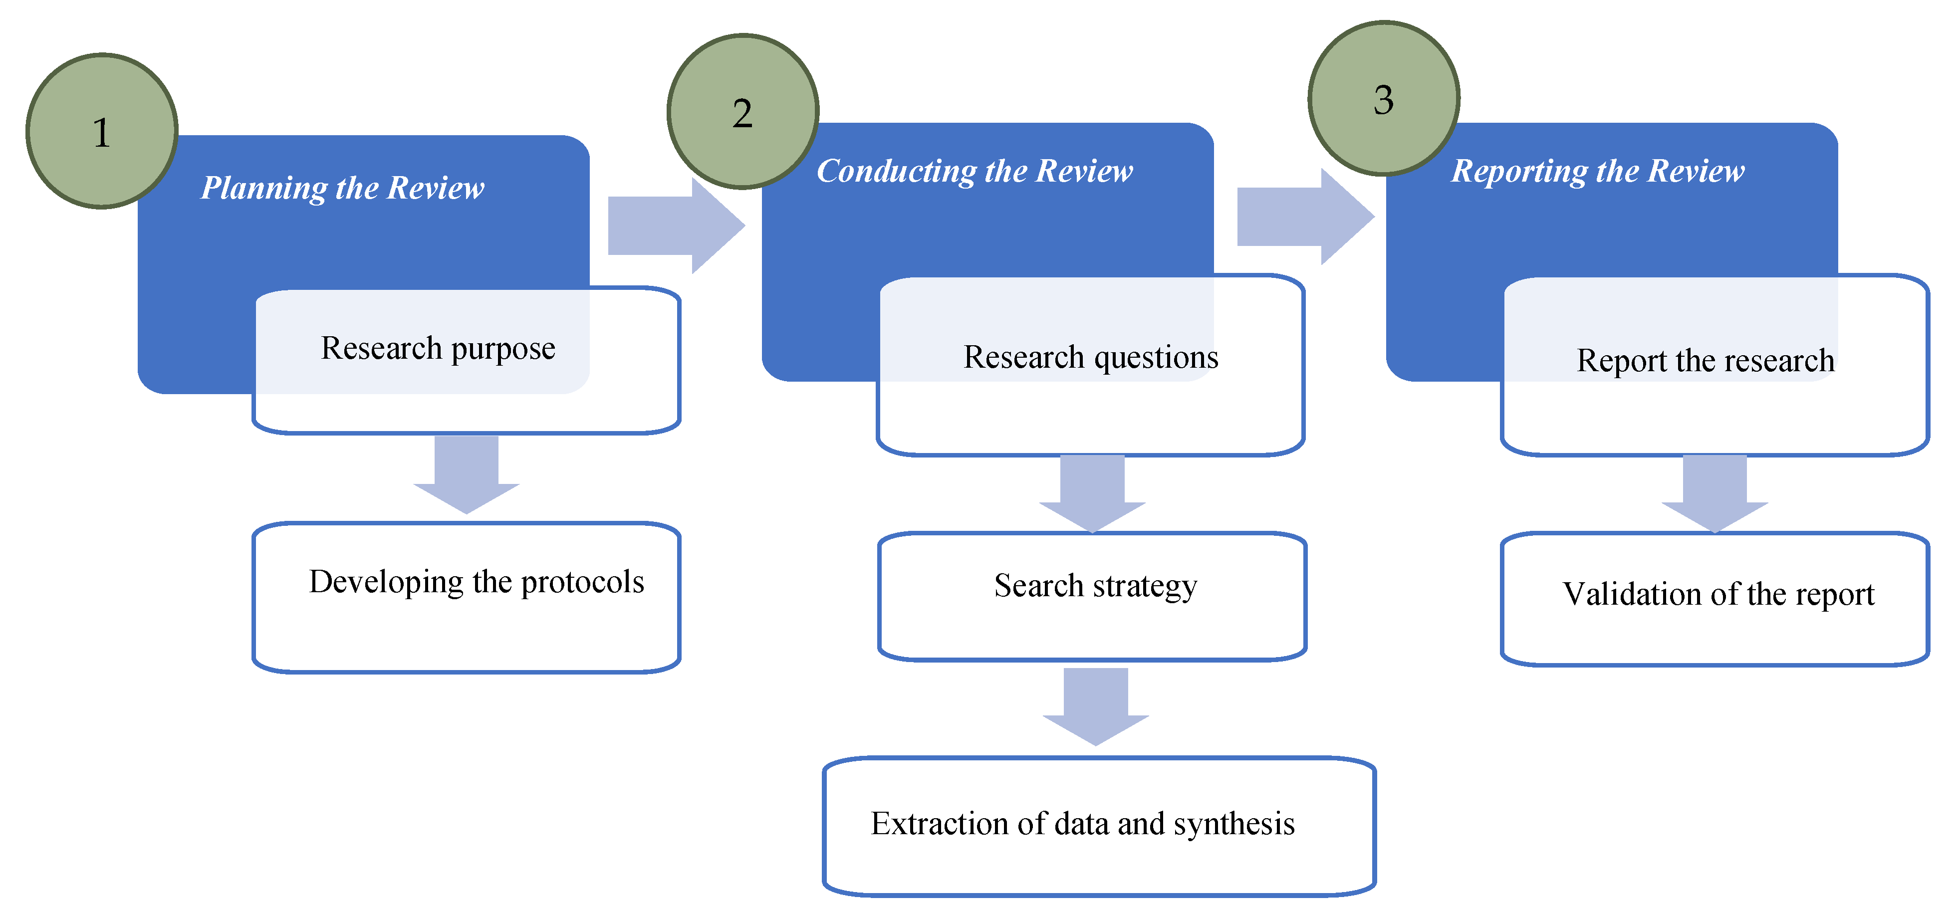
Sequance Diagrams

Slide 15
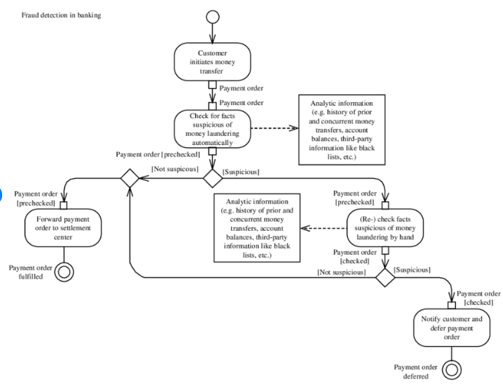
Active Diagrams

Slide 16
Final Output
The final output of the Fraud Detection in Digital and Net Banking Using Machine Learning project is a fully operational system that accurately identifies fraudulent transactions in real-time. By applying machine learning algorithms such as Convolutional Neural Networks (CNNs) and Principal Component Analysis (PCA), the system analyzes transaction data to detect anomalies and predict potential fraud. The model is trained to minimize false positives, providing an efficient and reliable fraud detection mechanism. The user interface, built using Streamlit, displays interactive visualizations of transaction patterns and fraud alerts, enhancing decision-making. The deployed system is capable of processing high-volume data quickly, making it suitable for integration with digital banking platforms to enhance security and customer trust. The overall system provides a scalable solution for detecting and preventing fraud in the ever-evolving world of online banking.

Slide 17
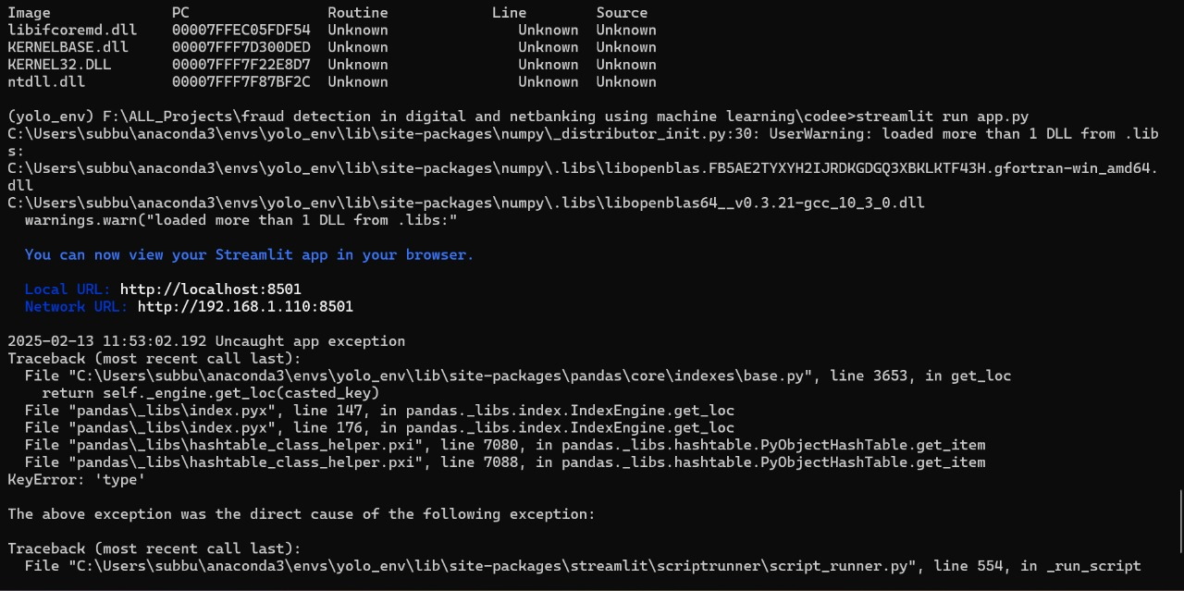
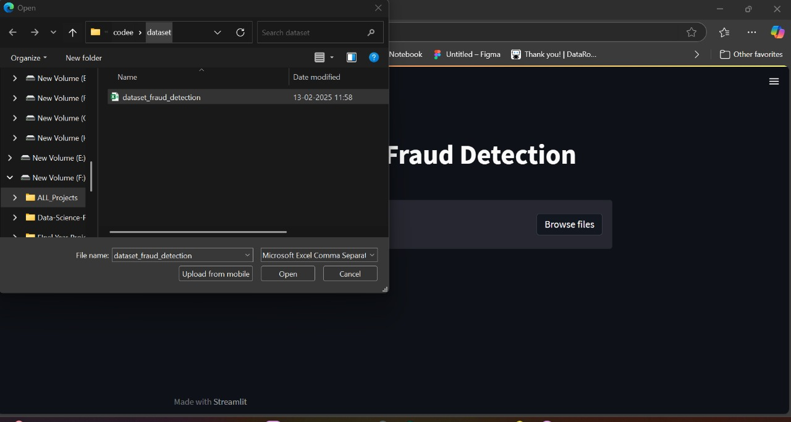
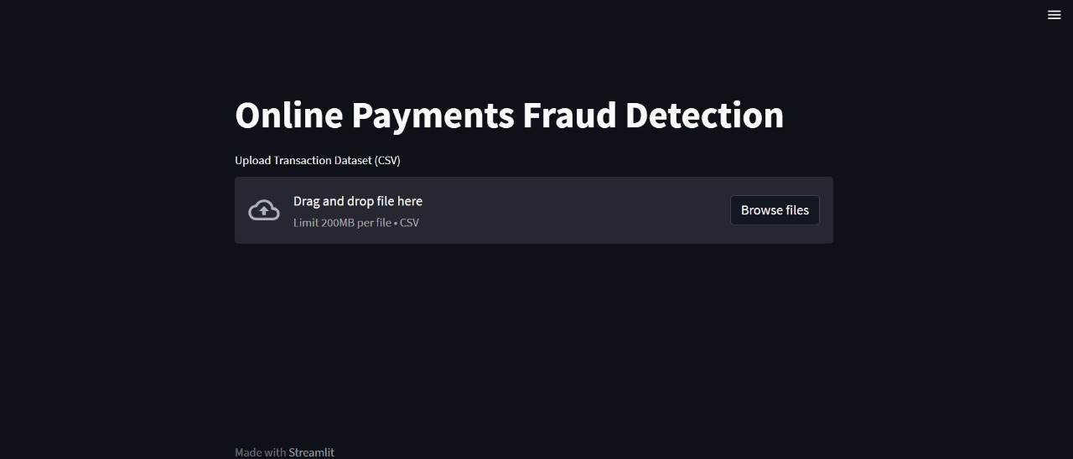
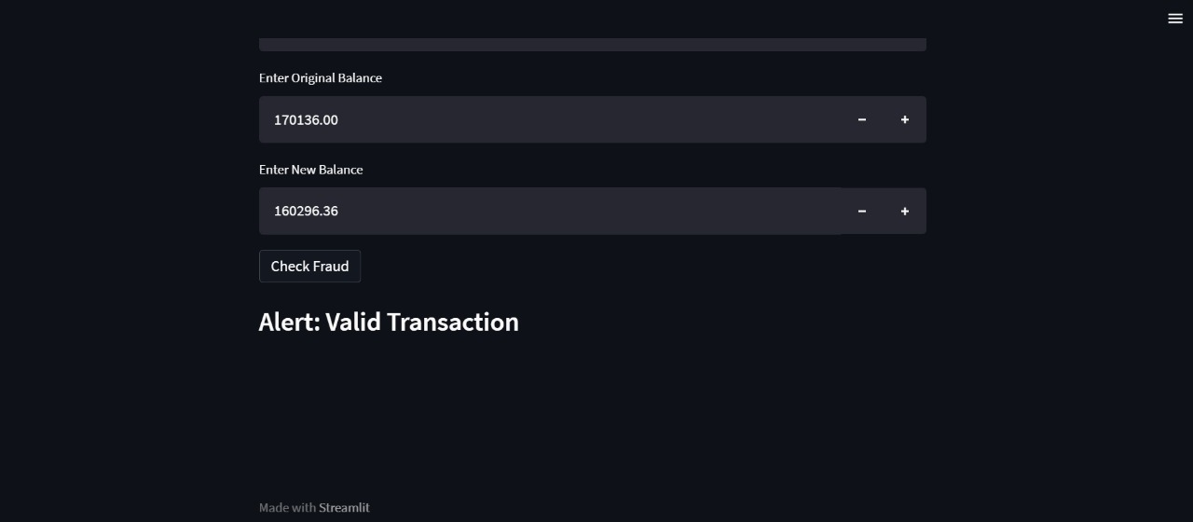
Final Output

Slide 18
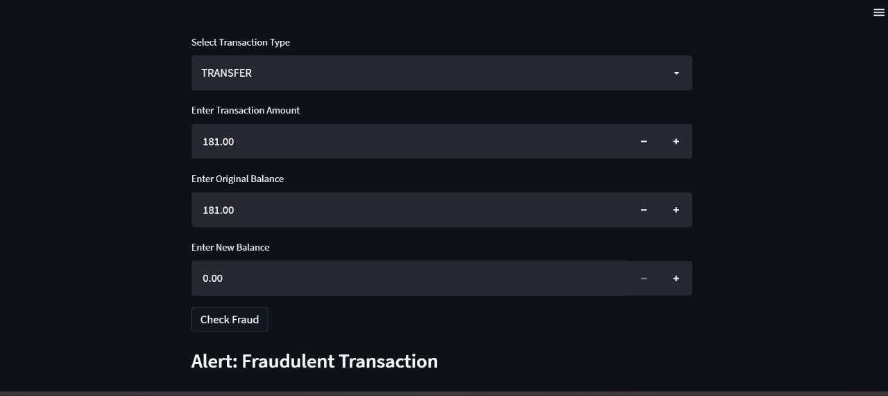
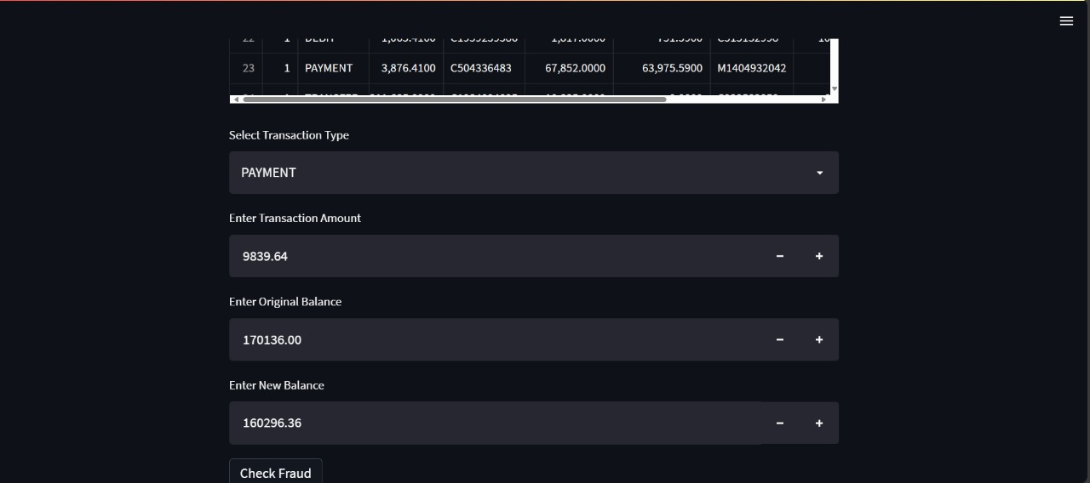
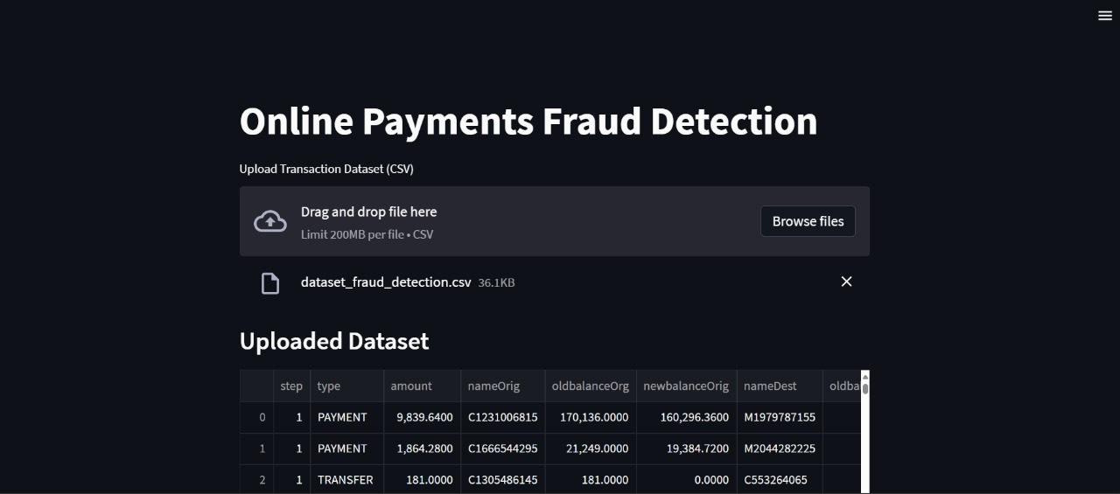
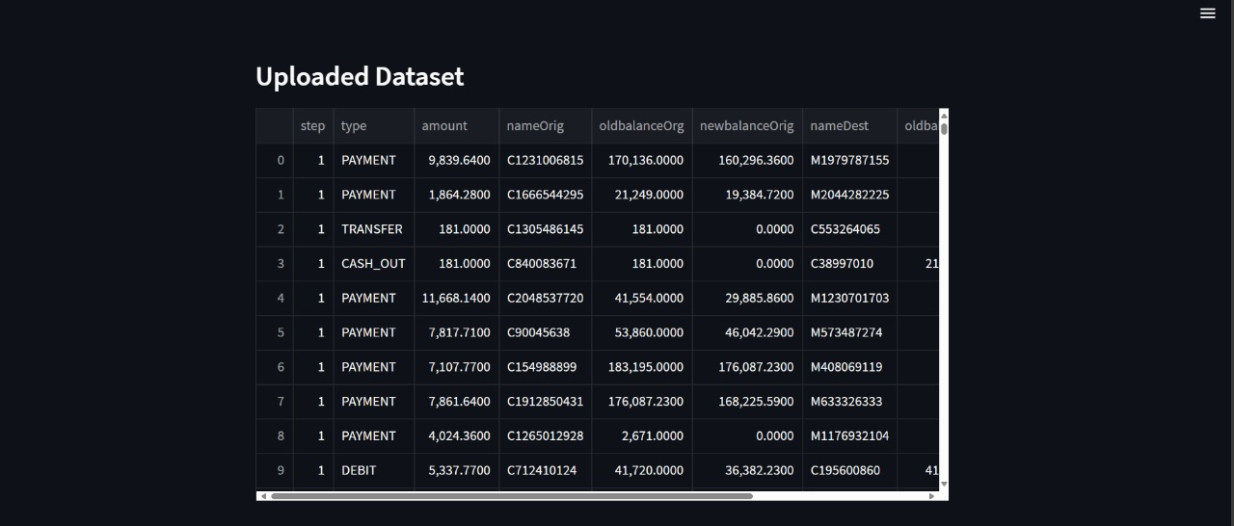
Final Output

Slide 19
Conclusion
The Fraud Detection in Digital and Net Banking Using Machine Learning project successfully leverages advanced machine learning techniques to provide a reliable and efficient solution for identifying fraudulent activities in real-time. By utilizing CNNs, PCA, and other cutting-edge algorithms, the system is capable of accurately detecting transaction anomalies and minimizing false positives. This approach enhances the security of digital banking platforms and ensures a safer user experience. The integration of interactive visualizations and easy-to-use dashboards allows for quick decision-making and improved fraud management. With its scalability and adaptability, this system represents a significant advancement in the fight against financial fraud, offering long-term benefits for financial institutions and customers alike.

